Slide 1
Lesson 2: Travelling.

Slide 2
Themes: Caring, helping

Slide 3
Starter Questions: How did you get to school this morning?
What other journeys have you made apart from your journey to school?
Did you know where you were going when you set off?
Was the weather different at the end of your journey to how it was at the start?

Slide 4
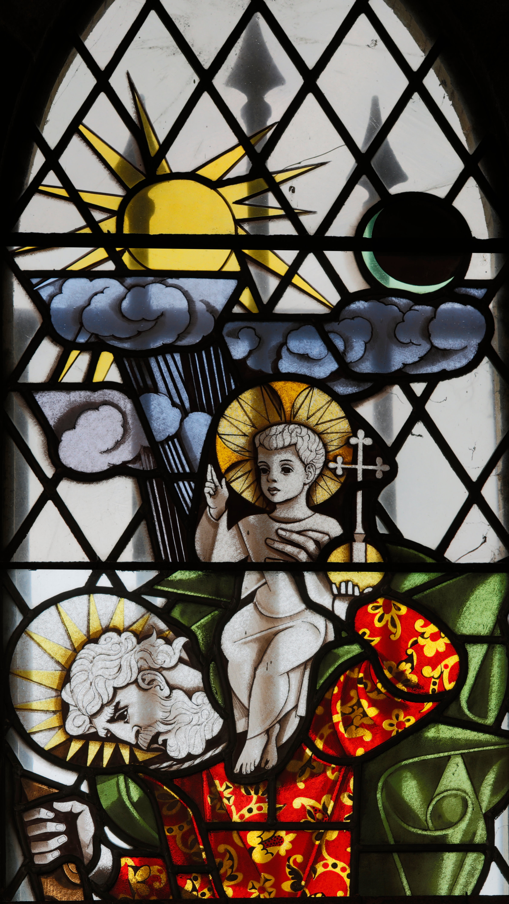
Armley Christ Church Window: St Christopher
This window shows St Christopher who was a very strong man. Legend says that he lived alone by a stream and used his strength to carry travellers across the water. One day, when Jesus was a child he asked to be carried to the other side and this is what you can see in the picture.
Apparently Jesus was very heavy because he is a very special person - the Creator and Redeemer of the world.
St Christopher was a helper. He helped people in their journeys. In the picture he has his foot on a rock. He is strong, safe and secure. We may not be as strong as St Christopher but we can still help others. It can be nice to help others but it can also be tiring and difficult. We can see that even St Christopher is feeling the burden of carrying Jesus.
Notes:
People who have to leave places that are not safe have to go on long, difficult and dangerous journeys. They may stay within their own country to escape danger in the place where they live or they may cross borders and travel through many different countries. Jesus looks innocent and happy in the picture. In the same way, we usually can’t tell by looking at someone what they have experienced in their past and what they have faced. We don’t always know what someone is feeling inside as a result of what has happened to them in life. Being kind and caring to others can make them feel better.
Notice the striking sun, moon, rain and clouds in the picture. This looks like England with all sorts of weather at once! The weather is different in different countries and can be an important factor for people travelling a long way to find safety. It can be yet another thing that is different to home and hard to adjust to. People may not have the right clothes for the new weather.

Slide 5
Omar was only four when he had to leave his home. Omar and Hassan walked and walked with thousands of other people mainly older people and mothers with children. They hid in bushes when they heard fighting. Sometimes bandits found them and stole all their food and belongings. They didn’t know where they were going but followed signs others had left such as a bent tree branch meaning ‘turn left here’. They didn’t know what they would eat on the way or if they would be in danger. Just as they were getting very weak, they found themselves in a safe place with many other people on the move. This place was ‘ Dadaab Refugee Camp’ in Kenya. They were so weak on arrival they spent a long time in hospital and had to learn to walk again despite having walked for many, many miles.
Notes:
P.186-189. Dadaab is a huge place where thousands of people live tents not just for a few days or months but often many years. It consists of three large camps with a bus running between the camps. P.14. There are schools and shops of all kinds which the inhabitants have started. Not all refugees go to a refugee camp but for many it is a vital safe place before they travel again either back to their own country or to a new country. A refugee is someone who has to leave their home country because it isn’t safe to stay there any more.

Slide 6
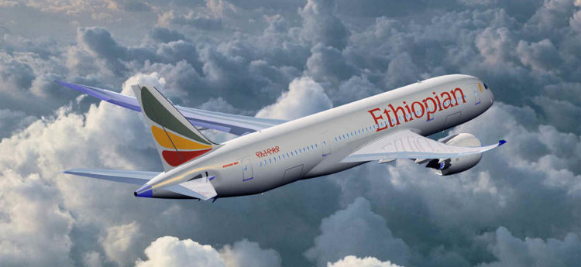
Samuel’s story Travelling…
We arrived in Addis Ababa and lived with my Aunt and her son for 2 years. I did not go to school whilst I was living here and just played with my brother and sister. I was waiting for a visa to come to England.
Eventually my visa arrived and I was able to come to England. I was excited as I was going to see my big brother and it was my first time on an aeroplane.

Slide 7
Discussion starters:
Do you know any refugees?
Which country have they come from?
What do you know about life in their country?
How can you make them feel welcome and at home here?

Slide 8
Activity suggestions
Go on a walking journey together as a class/school.
What do you see on the way that is interesting?
How is it different where you finish your journey to where you began? Do you feel different? Are your legs tired from walking?
Do it in different weather – sun and rain. How do your feelings differ? What did you need in the difficult weather?

Slide 9
Prayer
Thank you God for our friends and family and all the people and places we love.
Thank you for the journeys we enjoy and those who take care of us on our journeys
Thank you for kind, new and welcoming people at the end of the journeys in new places.
We pray for people who have to take difficult and dangerous journeys away from home.
Please give them peace in their hearts that you will take care of them and the people they love.

