Slide 1
Lesson 3. Arriving.

Slide 2
Themes: Diversity, Culture

Slide 3
Starter Questions:
Which country do you live in?
Do you have connections with any other countries?
Do you speak any other languages?

Slide 4
Armley Christ Church Window: St George
St George is the patron saint of England. The English flag is white with the red cross in the middle. You can see the red and white of the flag in the picture. There is also a lion which here represents England. The royal coat of arms used today to represent the United Kingdom shows a lion and the English flag.
The story of St George is that when he lived, just a few hundred years after Christ, the Romans were in power. St George was a Christian – he believed that Jesus was the Son of God - but he was asked to disown his faith by the Romans and instead to believe in the Roman gods.
He refused to do this and it didn’t end well for St George but we remember his bravery and courage and faith today, thousands of years later.
Notes:
St George’s Chapel is a special place in Windsor Castle and Queen Elizabeth II is buried in King George VI Memorial Chapel here. England is not the only country to have claimed St George as their patron saint. Other countries and regions around the world have claimed him as their saint as well because he was willing to die for his faith.

Slide 5
When Stars are Scattered
Eventually Omar and Hassan were safe in the refugee camp but it took time for them to settle in. They didn’t like the food and Omar couldn’t sleep well. His brother Hassan had seizures and people didn’t know how to deal with them. Omar and Hassan spent almost their whole childhood in a refugee camp. The camp was different to being at home. It wasn’t a peaceful village and they weren’t with their parents. In the camp, Omar remembers happy days in the fields having picnics with his mother and father and he remembers the colour green from his home village. The food was different in the camp. It was often the same, very basic and there was never enough of it. They were bored with nothing to do. They were assigned a foster mother, Fatuma who looked after them as well as a lady called Susana from the UNHCR which is a large organisation working to help refugees.
Notes:
Going to a new country or even a new place can be strange even if it isn’t far away. People speak differently whether they speak English but with a different accent or a different language. The ways people dress can be different as well as the ways they behave. If you arrive in a new place it can be difficult especially if you are a child. You have to go to school in a new country and start life all over again in a new place. Parents may not know how to prepare the food in the shops and yet are not easily able to find the food they are used to. P.9-25.
P.190

Slide 6
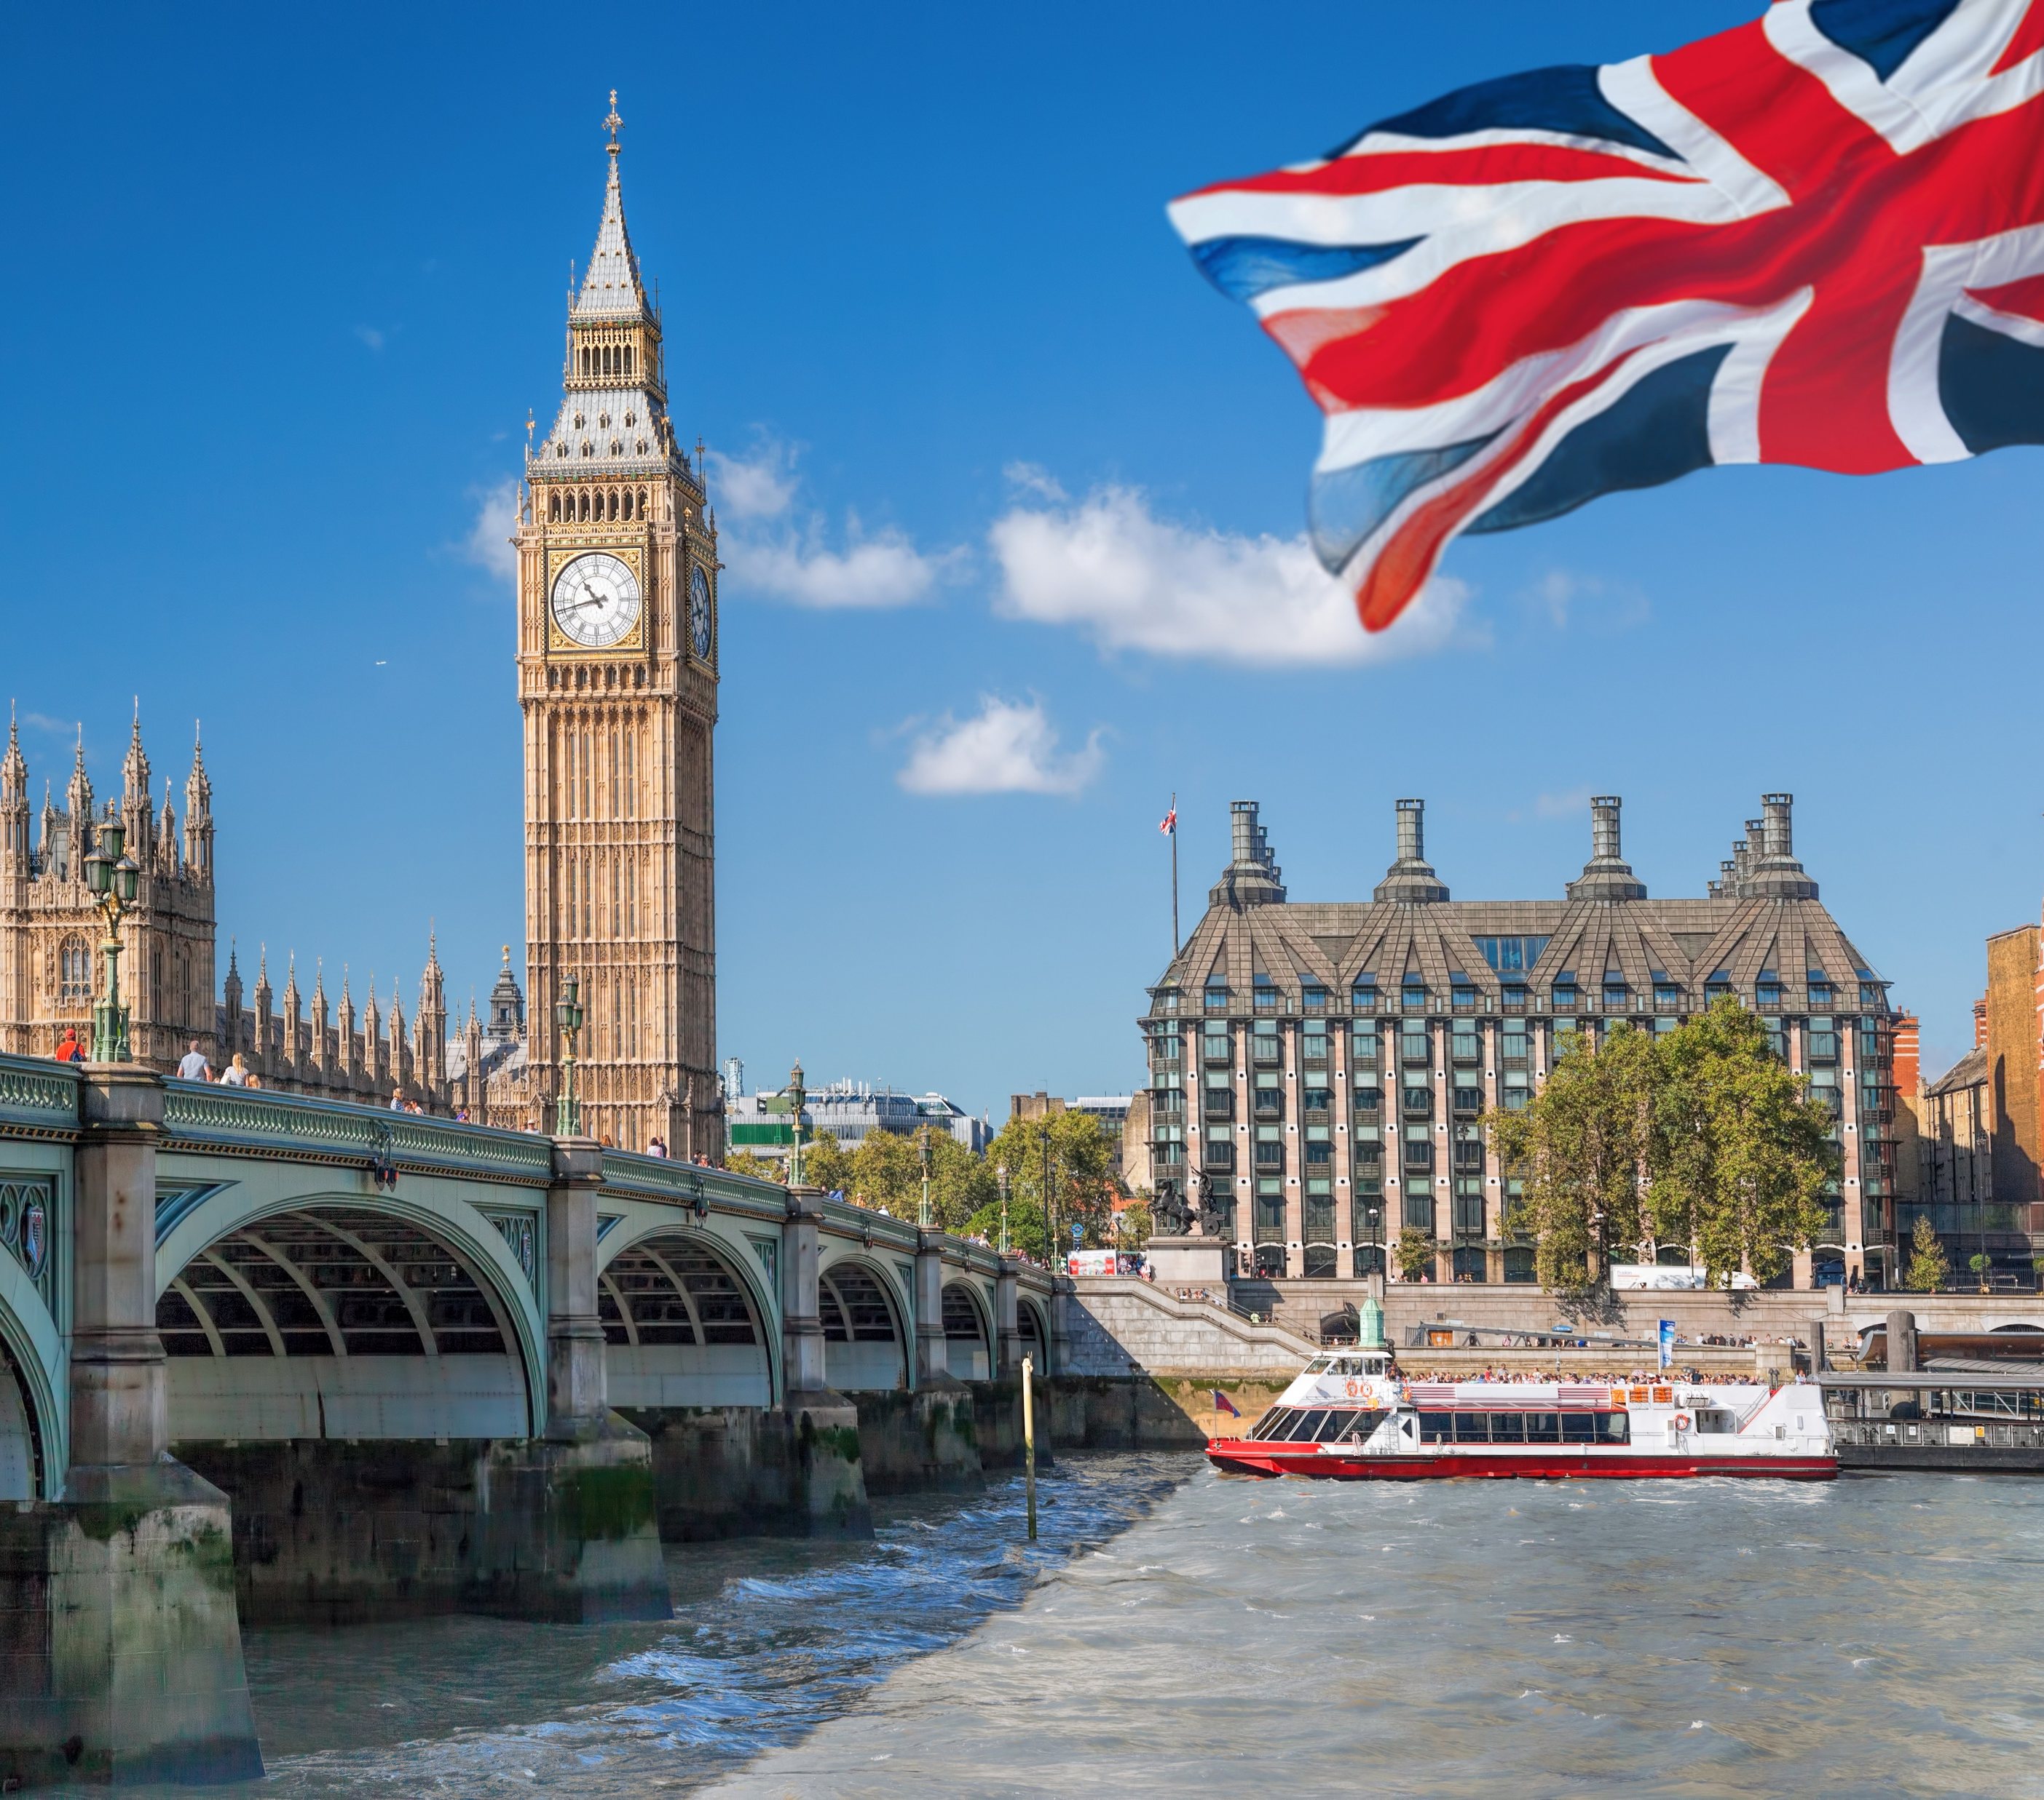
Samuel in England…London and finally Leeds.
We flew to Egypt and spent 2 nights in a hotel and after that we took a plane to London. I spent 2 weeks in Covid quarantine at a hotel in London before my brother came to meet us and took us on a train to Leeds. This was my first time on a train.
I arrived in the summer time so the weather was not too different but the city was very different.
I arrived in Leeds and my brother took us to his house. He was sharing the house with other people so 4 of us all lived in the same room. I lived with my brother for 1 month before we moved to another house by ourselves where we lived for a couple of weeks.

Slide 7
Discussion starters:
St George’s Day is celebrated on 23 April. We call him a Patron Saint. Do you know any other patron Saints? For example the patron saint of Wales, Ireland and Scotland?
Do you know the symbols associated with these saints?
What is important in other countries you have connections with? Are there special days?
Notes:
What is typical English food? Is this different to the food you typically eat at home?

Slide 8
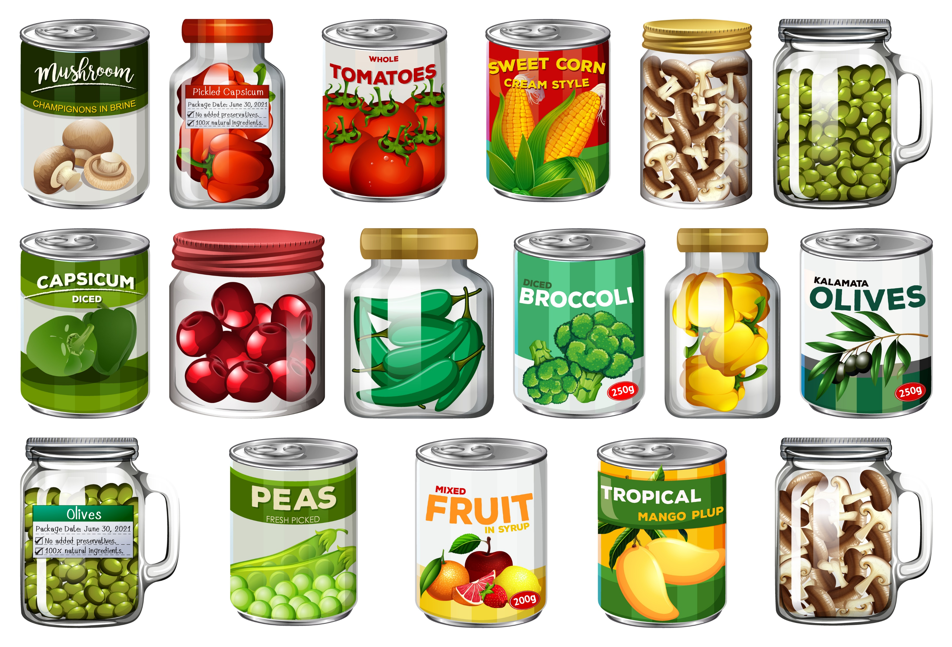
Activity suggestions
Share food with one another whether it is English or from another country.
Dress up in traditional clothes from countries you have connections with.
Sing songs and celebrate traditional cultures.

Slide 9
Prayer
Thank you God for our friends and family and all the people and places we love.
Thank you that we are not all the same but that we are different and we can celebrate this.
Thank you for the food and clothes we enjoy here and the traditions here and in every country.
We pray for children who are finding it difficult in England because it’s not their home country.
Help us to be people who welcome them with big smiles and accept them for who they are.

