Slide 2
22nd of June 2023 People living in Leeds who are first and second Windrush generation, their families and community organisations from all across Leeds, gathered in Chapeltown to celebrate 75 years since the arrival of HMS Windrush
The Windrush Generation denotes the people who emigrated from the Caribbean to Britain between the arrival of the HMT Empire Windrush on 22 June 1948 and the Immigration Act 1971

Slide 3
In your local community, school or parish think who you could work alongside to organise a Windrush celebration lunch.
There are lots of organisations and individuals you can reach out to for help. You can offer your hand of friendship and cooperation.
‘Love your neighbour’
Mark 12:30-31
Cooperation
The Windrush 75 celebration lunch was organised in partnership with the BAME Wellbeing Hub in Chapeltown with guest speakers

Slide 4
In your daily prayers, worship or reflection take time to be reminded of the hope felt among the first Windrush generation who arrived in Leeds.
Inspired by their confidence, we reflect on the welcome we offer to people arriving to our city in 2023 and think about how we can show we really are a compassionate city.
‘Love your neighbour’
Mark 12:30-31
Faith
People of all faiths joined to give thanks and praise for those who came to Leeds on Emprie Windrush on 22nd June 1948 and in the decades that followed.

Slide 5
Have a think about people you know in your local community who have travelled a distance and made Leeds their home.
Invite people who have lived experience of Windrush and their families to speak at your school assembly, church or community event and invite your local MP or news crew.
‘Love your neighbour’
Mark 12:30-31
Learning
Activities, games and Caribbean food helped us to learn more about the Windrush generation. Guest speakers shared their stories on BBC and Channel 4 news.

Slide 6
Work together to stand up to racism and all forms of discrimination.
Make positive choices to show respect, kindness and understanding of all cultures. Join up as a member of Leeds Church Institute as we continue to offer a hand of friendship to those who are marginalised and oppressed.
‘Love your neighbour’
Mark 12:30-31
Justice
We came together to show solidarity and support for all those who have felt the pain of discrimination and we continue to work together for racial justice and human rights.

Slide 7
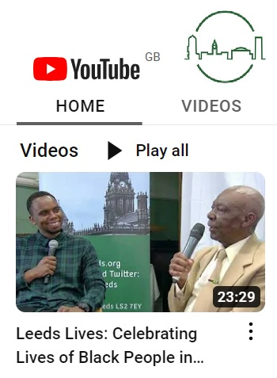
Find out more
Dwayne Hutchinson
Faith and Racial Justice Lead
Leeds Church Institute
justice@leedschurchinstitute.org
Click the arrow to hear Brother Chrouch’s journey from Jamaica to Leeds, tales of forgiveness and friendship and a gentle reminder for us all to ‘Love your neighbour’.
www.lcileeds.org

